Slide 1
Chapter 7: Entity-Relationship Model

Slide 2
Reading
Chapter 7
  Sections 7.1 to 7.7
Please note that these set of slides is not comprehensive and reading Chapter 7 is required.

Slide 3
Modeling
A database can be modeled as:
  A collection of entities, and
  relationships among entities.
An entity is an object that exists and is distinguishable from other objects.
  Example: specific person, company, event, plant
Entities have attributes
  Example: people have names and addresses
An entity set is a set of entities of the same type that share the same properties.
  Example: set of all persons, companies, trees, holidays

Slide 4

Entity Sets instructor and student
instructor_ID instructor_name student-ID student_name

Slide 5
Relationship Sets
A relationship is an association among several entities
Example:
44553 (Peltier) advisor 22222 (Einstein)
student entity relationship set instructor entity
A relationship set is a mathematical relation among n ≥ 2 entities, each taken from entity sets
{(e₁, e₂, … e_{n}) | e₁ ∈ E₁, e₂ ∈ E₂, …, e_{n} ∈ E_{n}}
where (e₁, e₂, …, e_{n}) is a relationship
  Example:
  (44553,22222) ∈ advisor

Slide 6

Relationship Set advisor

Slide 7

Relationship Sets (continued)
An attribute can also be property of a relationship set.
For instance, the advisor relationship set between entity sets instructor and student may have the attribute date which tracks when the student started being associated with the advisor

Slide 8
Degree of a Relationship Set
Binary Relationship
  involve two entity sets
Most relationship sets in a database system are binary.
Relationships between more than two entity sets are rare.
  Example: students work on research projects under the guidance of an instructor.
    relationship proj_guide is a ternary relationship between instructor, student, and project

Slide 9
Attributes
An entity is represented by a set of attributes, that is descriptive properties possessed by all members of an entity set.
  Example:
  instructor = (ID, name, street, city, salary )
  course= (course_id, title, credits)
Domain – the set of permitted values for each attribute
Attribute types:
  Simple and composite attributes.
  Single-valued and multivalued attributes
    Example: multivalued attribute: phone_numbers
  Derived attributes
    Can be computed from other attributes
    Example: age, given date_of_birth

Slide 10

Composite Attributes

Slide 11
Mapping Cardinality Constraints
Express the number of entities to which another entity can be associated via a relationship set.
Most useful in describing binary relationship sets.
For a binary relationship set the mapping cardinality must be one of the following types:
  One to one
  One to many
  Many to one
  Many to many

Slide 12

Mapping Cardinalities
One to one
One to many
Note: Some elements in A and B may not be mapped to any
elements in the other set

Slide 13

Mapping Cardinalities
Many to one
Many to many
Note: Some elements in A and B may not be mapped to any
elements in the other set

Slide 14
Keys
A super key of an entity set is a set of one or more attributes whose values uniquely determine each entity.
A candidate key of an entity set is a minimal super key
  ID is candidate key of instructor
  course_id is candidate key of course
Although several candidate keys may exist, one of the candidate keys is selected to be the primary key.

Slide 15
Keys for Relationship Sets
The combination of primary keys of the participating entity sets forms a super key of a relationship set.
  (s_id, i_id) is the super key of advisor
  NOTE: this means a pair of entity sets can have at most one relationship in a particular relationship set.
Must consider the mapping cardinality of the relationship set when deciding what are the candidate keys
Need to consider semantics of relationship set in selecting the primary key in case of more than one candidate key

Slide 16
Redundant Attributes
Suppose we have entity sets
  instructor, with attributes including dept_name
  department
  and a relationship
  inst_dept relating instructor and department
Attribute dept_name in entity instructor is redundant since there is an explicit relationship inst_dept which relates instructors to departments
  The attribute replicates information present in the relationship, and should be removed from instructor
  BUT: when converting back to tables, in some cases the attribute gets reintroduced, as we will see.

Slide 17

E-R Diagrams
Rectangles represent entity sets.
Diamonds represent relationship sets.
Attributes listed inside entity rectangle
Underline indicates primary key attributes

Slide 18

Entity With Composite, Multivalued, and Derived Attributes

Slide 19

Alternate Notation

Slide 20

Relationship Sets with Attributes

Slide 21
Cardinality Constraints
We express cardinality constraints by drawing either a directed line (→), signifying “one,” or an undirected line (—), signifying “many,” between the relationship set and the entity set.
One-to-one relationship:
  A student is associated with at most one instructor via the relationship advisor
  A student is associated with at most one department via stud_dept

Slide 22

Figure 7.09

Slide 23
One-to-One Relationship
one-to-one relationship between an instructor and a student
  an instructor is associated with at most one student via advisor
  and a student is associated with at most one instructor via advisor

Slide 24
One-to-Many Relationship
one-to-many relationship between an instructor and a student
  an instructor is associated with several (including 0) students via advisor
  a student is associated with at most one instructor via advisor,

Slide 25
Many-to-One Relationships
In a many-to-one relationship between an instructor and a student,
  an instructor is associated with at most one student via advisor,
  and a student is associated with several (including 0) instructors via advisor

Slide 26
Many-to-Many Relationship
An instructor is associated with several (possibly 0) students via advisor
A student is associated with several (possibly 0) instructors via advisor

Slide 27

Participation of an Entity Set in a Relationship Set
Total participation (indicated by double line): every entity in the entity set participates in at least one relationship in the relationship set
  E.g., participation of section in sec_course is total
    every section must have an associated course
Partial participation: some entities may not participate in any relationship in the relationship set
  Example: participation of instructor in advisor is partial

Slide 28

Alternative Notation for Cardinality Limits
Cardinality limits can also express participation constraints

Slide 29
Weak Entity Sets
An entity set that does not have a primary key is referred to as a weak entity set.
The existence of a weak entity set depends on the existence of a identifying entity set
  It must relate to the identifying entity set via a total, one-to-many relationship set from the identifying to the weak entity set
  Identifying relationship depicted using a double diamond
The discriminator (or partial key) of a weak entity set is the set of attributes that distinguishes among all the entities of a weak entity set.
The primary key of a weak entity set is formed by the primary key of the strong entity set on which the weak entity set is existence dependent, plus the weak entity set’s discriminator.

Slide 30
Weak Entity Sets (continued)
We underline the discriminator of a weak entity set with a dashed line.
We put the identifying relationship of a weak entity in a double diamond.
Primary key for section – (course_id, sec_id, semester, year)

Slide 31
Weak Entity Sets (continued)
Note: the primary key of the strong entity set is not explicitly stored with the weak entity set, since it is implicit in the identifying relationship.
If course_id were explicitly stored, section could be made a strong entity, but then the relationship between section and course would be duplicated by an implicit relationship defined by the attribute course_id common to course and section

Slide 32

Design Issues
Use of entity sets vs. attributes
Use of phone as an entity allows extra information about phone numbers (plus multiple phone numbers)

Slide 33

Design Issues
Use of entity sets vs. relationship sets
Possible guideline is to designate a relationship set to describe an action that occurs between entities

Slide 34
Design Issues
Binary versus n-ary relationship sets
Although it is possible to replace any nonbinary (n-ary, for n > 2) relationship set by a number of distinct binary relationship sets, a n-ary relationship set shows more clearly that several entities participate in a single relationship.
Placement of relationship attributes
e.g., attribute date as attribute of advisor or as attribute of student

Slide 35
E-R Design Decisions
The use of an attribute or entity set to represent an object.
Whether a real-world concept is best expressed by an entity set or a relationship set.
The use of a ternary relationship versus a pair of binary relationships.
The use of a strong or weak entity set.

Slide 36
Reduction to Relational Schemas

Slide 37
Reduction to Relation Schemas
Entity sets and relationship sets can be expressed uniformly as relation schemas that represent the contents of the database.
A database which conforms to an E-R diagram can be represented by a collection of schemas.
For each entity set and relationship set there is a unique schema that is assigned the name of the corresponding entity set or relationship set.
Each schema has a number of columns (generally corresponding to attributes), which have unique names.

Slide 38
Representing Entity Sets With Simple Attributes
A strong entity set reduces to a schema with the same attributes
student(ID, name, tot_cred)
A weak entity set becomes a table that includes a column for the primary key of the identifying strong entity set
section ( course_id, sec_id, sem, year )

Slide 39
Mapping many-to-many Relationships
A many-to-many relationship set is represented as a schema with attributes for the primary keys of the two participating entity sets, and any descriptive attributes of the relationship set.
Example: schema for relationship set advisor
advisor = (s_id, i_id)

Slide 40

Mapping Many-to-one Relationships
Many-to-one and one-to-many relationship sets that are total on the many-side can be represented by adding an extra attribute to the “many” side, containing the primary key of the “one” side
Example: Instead of creating a schema for relationship set inst_dept, add an attribute dept_name to the schema arising from entity set instructor

Slide 41
Mapping one-to-one Relationships
For one-to-one relationship sets, either side can be chosen to act as the “many” side
  That is, extra attribute can be added to either of the tables corresponding to the two entity sets

Slide 42
Composite and Multivalued Attributes
Composite attributes are flattened out by creating a separate attribute for each component attribute
  Example: given entity set instructor with composite attribute name with component attributes first_name and last_name the schema corresponding to the entity set has two attributes name_first_name and name_last_name
    Prefix omitted if there is no ambiguity
Ignoring multivalued attributes, extended instructor schema is
  instructor(ID,
  first_name, middle_initial, last_name,
  street_number, street_name,
  apt_number, city, state, zip_code,
  date_of_birth)

Slide 43
Composite and Multivalued Attributes
A multivalued attribute M of an entity E is represented by a separate schema EM
  Schema EM has attributes corresponding to the primary key of E and an attribute corresponding to multivalued attribute M
  Example: Multivalued attribute phone_number of instructor is represented by a schema:
  inst_phone= ( ID, phone_number)
  Each value of the multivalued attribute maps to a separate tuple of the relation on schema EM
    For example, an instructor entity with primary key 22222 and phone numbers 456-7890 and 123-4567 maps to two tuples:
    (22222, 456-7890) and (22222, 123-4567)

Slide 44
E-R Diagram for a University Enterprise

Slide 45
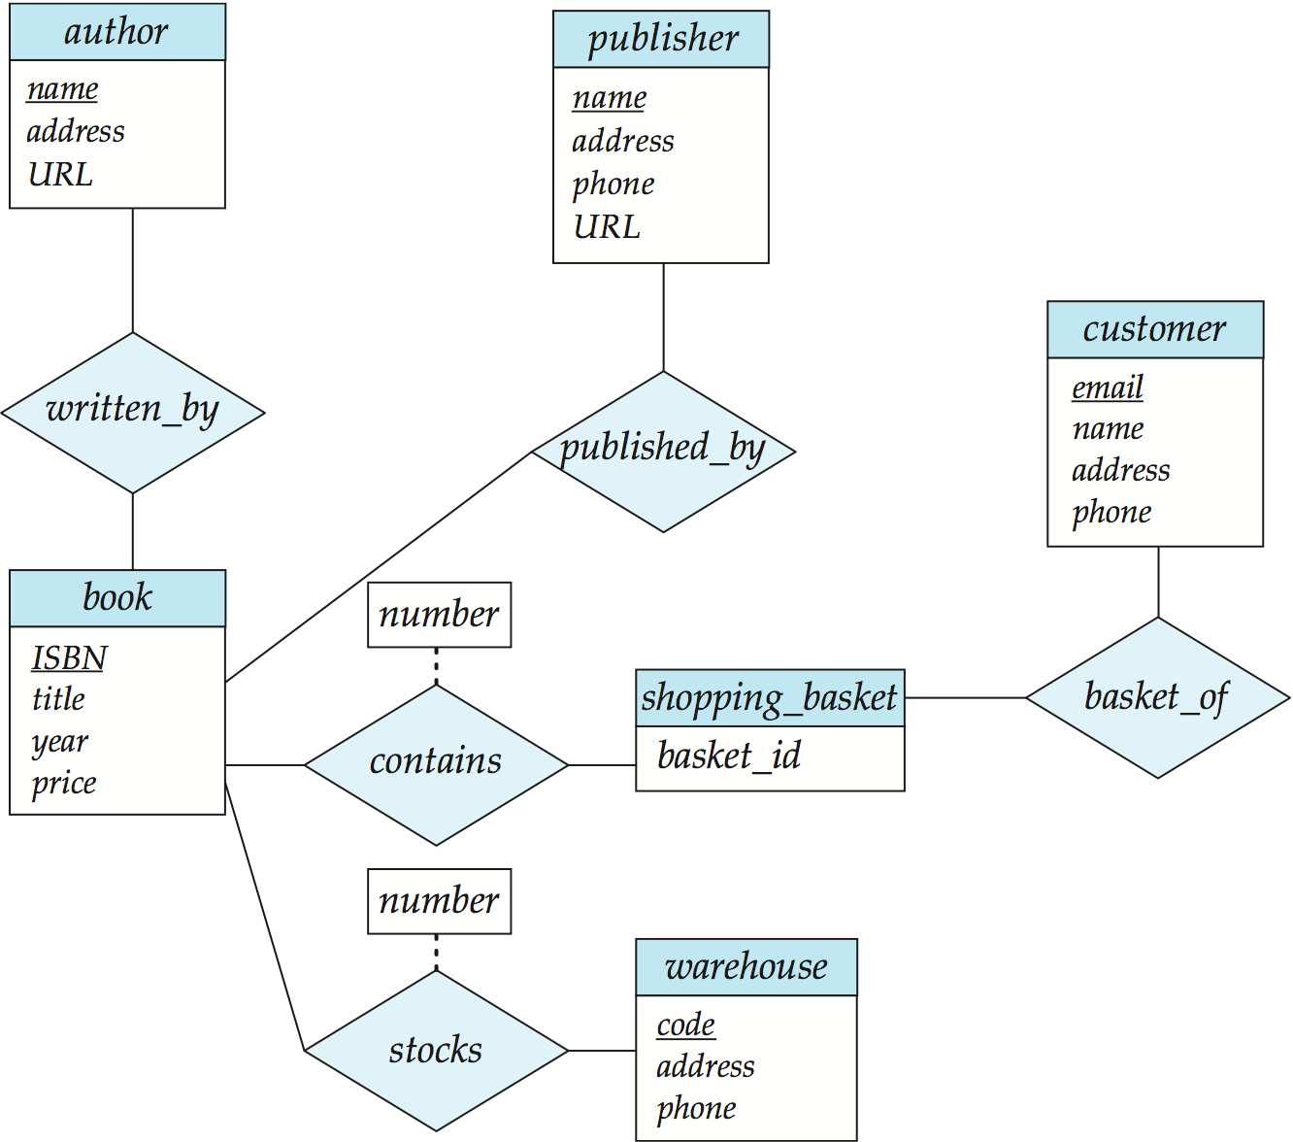
Example 1: ERD for a Book Store

Slide 46
Example 2
A supplier supplies many parts, and a part can be supplied by many suppliers

Slide 47
Example 3
A dealer can deal with many manufacturers, and a manufacturer can deal with many dealers.
Dealers can sell many vehicle types and vehicle types can be sold by many dealers.
Manufacturers can make many vehicles and a vehicle can be made by many manufacturers.

Slide 48
Example 4
A department employs many employees, but each employee is employed by one department.
Some employees, known as “rovers,” are not assigned to any department.
A division operates many departments, but each department is operated by one division.
An employee may be assigned many projects, and a project may have many employees assigned to it.
One of the employees manages each department, and each department is managed by only one employee.
One of the employees runs each division, and each division is run by only one employee.

Slide 49
Example 5
Construct ER diagram for a car insurance company where:
Customers own one or more cars each
Each car has associated with zero to any number of recorded accidents.
Each insurance policy covers one or more cars, has one or more premium payments associated with it.
Each payment is for a particular period of time, and has an associated due date, and the date when the payment was received.

Slide 50
Example 6
A chain of pharmacies has offered you a free lifetime supply of medicine if you design its database. Here’s the information that you gather:
Patient records include an SSN, name, address, and age.
Doctor records include SSN, name, specialty, and years of experience.
Each pharmaceutical company is identified by name and has a phone no.
For each drug, the trade name and formula must be recorded. Each drug is sold by a given pharmaceutical company, and the trade name identifies a drug uniquely from among the products of that company. If a pharmaceutical company is deleted, you need not keep track of its products
Each pharmacy has a name, address, and phone number.

Slide 51
Example 6 (continued)
Every patient has a primary physician. Every doctor has at least one patient.
Each pharmacy sells several drugs and has a price for each. A drug could be sold at several pharmacies with different price.
A doctor could prescribe one or more drugs for several patients, and a patient could obtain prescriptions from several doctors.
Each prescription has a date and a quantity associated with it. You can assume that, if a doctor prescribes the same drug for the same patient more than once, only the last such prescription needs to be stored.
Pharmaceutical companies have long-term contracts with pharmacies. A pharmaceutical company can contract with several pharmacies, and a pharmacy can contract with several pharmaceutical companies. For each contract, you have to store a start date, end date, and the text of the contract.
Draw an ER diagram that captures the preceding information.

Slide 52
Example 7
Notown Records has decided to store information about musicians who perform on its albums (as well as other company data) in a database.
Each musician that records at Notown has an SSN, a name, an address, and a phone number.
Each instrument used in songs recorded at Notown has a unique identification number, a name, and a musical key.
Each album recorded on the Notown label has a title, a copyright date, a format, and an album identifier.
Each song recorded at Notown has a title and an author.
Each musician may play several instruments, and a given instrument may be played by several musicians.
Each album has a number of songs on it, but no song may appear on more than one album.
Each song is performed by one or more musicians, and a musician may perform a number of songs.
Each album has exactly one musician who acts as its producer. A musician may produce several albums, of course.
Design a conceptual schema/ ER diagram for Notown

